Slide 1
Hutton Settlement
Leadership Spokane Capstone Project 2020

Slide 2
Hutton Settlement: A Home For Children In Need
Hutton Settlement nurtures, educates and prepares children in need of a home. The team provides residential care in an attachment parenting style to empower each child to lead an independent and fulfilled life of value and contribution.
50+
100
5.2
100%
Children served each year
Number of years in service
Average years child onsite
Kids graduating high school
(last 10 years)

Slide 3
Hutton Houseparents
12 Houseparents in 4 homes. 8 kids per house.
All Houseparents must be couples.
4 couples work at a time. 8 days on, 3 days off.
Goal is 5+ years in service. Currently at 3 years or less.
Compensation of $60,000 per couple, health benefits, training, counseling and live onsite.
Ideal couple: mid 30s-40s with family / empty nesters. Many Houseparents come from a background in education or foster parenting.
Board continuing capital raise, with next $2 million earmarked for Houseparents and staff.
Leadership working toward increased compensation, retention bonuses and additional incentives.

Slide 4
Our Mission
A request for help:
The major challenge at Hutton Settlement is recruiting Houseparents due to depth of work, unique accommodations and the need to hire a couple.
Hutton uses Attachment-Based parenting methods, so it is critical to recruit the best people and retain staff for long-term employment.
Houseparents are essential for Hutton Settlement’s mission of providing transformational care for children in need and delivering successful outcomes.
Hutton Settlement asks the Leadership Spokane team to meet with staff, evaluate current Houseparent recruitment methods and prepare recruitment strategy recommendations.
To offer recommendations to help Hutton Settlement improve Houseparent recruitment and retention.

Slide 5
Houseparent Job Description
Responsible for development of relationships with each assigned child
Participates in Circle of Security parent consultations
Promotes a sense of belonging for children in care through activities
Teaches and encourages children in the development of habits and values
Plans, supervises and participates in daily activities, including social, recreational, chores, spiritual and school
Teaches health principles and monitors children’s personal hygiene and nutrition.
Monitors children’s medical and dental needs, and assists with attendance at counseling sessions as needed.
Assists with planning and implementation of weekly menu plan
Implements housekeeping program and maintains cottage cleanliness
Promotes sense of community contribution with children around areas of campus and grounds
Assists with inventories and inspects cottage regularly, and conducts monthly fire drills
Organizes, encourages, assists and supervises children’s educational activities
Serves as member of the houseparent team to assist with decision making and promote clear communication
Maintains healthy, supportive relationships and connections with children’s family and staff
Participates in staff conferences, training programs, case meetings and unit meetings
Requirements:
Minimum of high school diploma, college degree preferred. Two years experience working or living with children. Willingness to live full-time in an intentional community setting.

Slide 6
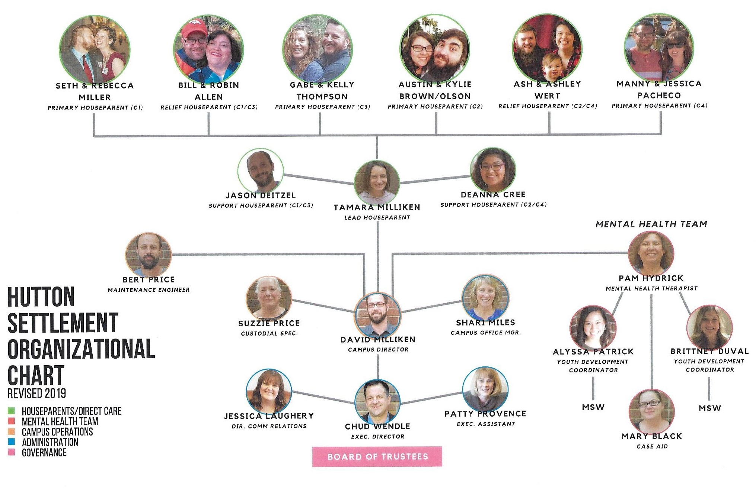
Hutton Settlement Organization Chart

Slide 7
Research
Learning about Hutton Settlement: Leaders Who Listen
Our team split into Market Research and Interview Team to better understand how Houseparents are located, what is important for them in the role and what might lead to increased retention.

Slide 9
Houseparent Questionnaire
What are the benefits of working at Hutton Settlement?
How did you find the job at Hutton?
What were you doing before you came to Hutton?
What attracted you to the house parent role?
What would have made the application process better for you? How was your application/interview experience?
What defines the Hutton Settlement's culture? How would you describe the work environment?
The team asked questions to learn about the role.

Slide 10
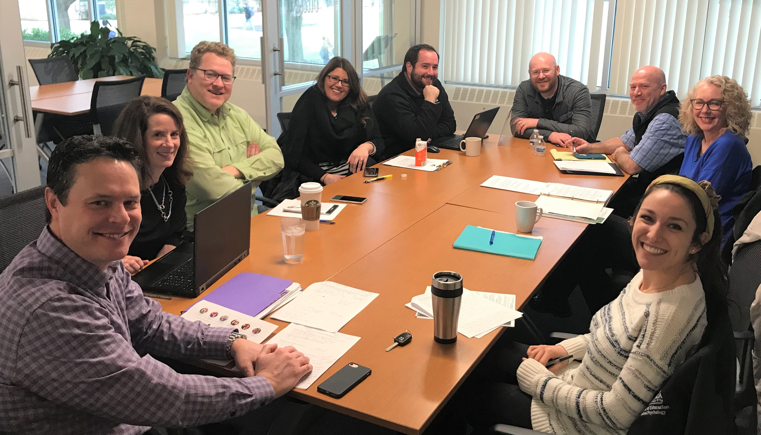

Slide 11
Challenges for Houseparents
Emotionally draining position
Sleep deprivation
Burnout from lack of time off
Family planning
No transition period for new children
Having own children as a Houseparent
Low compensation
No upward mobility options

Slide 12
The Paths Not Taken
Ideas from the team that were not pursued for inclusion.
Change the organizational chart due to management of family members and inefficiencies in Houseparent system.
It was decided that this was political and not within the scope of our expertise.
A program with University of Washington to educate students in this field
This is was outside the scope of what Hutton Settlement asked for from our team
Looking into changes of Board structure - Members are lifetime appointees to the Board of Directors
It was decided that this was very political and not our role to research further.
Flagship community event to educate the community and therefore get the word out.
Community outreach is not directly linked with locating and hiring Houseparents
Public relations to increase community understanding of Hutton Settlement.
Hutton already had amazing press due to a community play and KSPS segment.

Slide 13
Recommended Solutions
Through research and interviews, we offer the following solutions to improve recruitment and retention of Houseparents at Hutton Settlement.

Slide 14
Partnership with regional universities
Goal: Create a pipeline of potential Houseparents with an education in a field related to Hutton Settlement’s mission.
Connect with faculty of programs that align with being a Houseparent, including: Masters in Counseling and Therapy, Theology and Leadership, Early Childhood Education, Psychology.
Contact university career counselors to locate advance degree students in an effort to hire upon graduation.
Gonzaga University programs
Special Education https://www.gonzaga.edu/catalogs/current/graduate/school-of-education/special-education
Psychology https://www.gonzaga.edu/college-of-arts-sciences/departments/psychology
Educational Leadership and Administrations https://www.gonzaga.edu/catalogs/current/graduate/school-of-education/educational-leadership-and-administration
Eastern Washington University programs
School of Social Work https://www.ewu.edu/css/social-work/social-work/
Dept. of Education Graduate Programs online https://sites.ewu.edu/educgrad/online/
Whitworth University programs
Master of Arts in Teaching, Applied Behavior Analysis, Marriage and Family Therapy, Education in Social and Behavioral Health, School Counseling.
https://www.whitworth.edu/cms/administration/career-services/students/job-search-resources/

Slide 15
Internship Program
Goal: Engage students to assist in the recruitment process.
Assess Hutton Settlement project management needs and outline objectives.
Create a hiring plan with role responsibilities, including hours, compensation, location and other details.
Connect with universities internship program coordinators to recruit candidates.
Establish learning objectives with benchmarks.
Assign specific projects to complete from start to finish with summary report given to supervisor and faculty.
Provide mentorship and specific feedback on strengths, accomplishments and opportunities for growth.
Potential intern responsibilities
Manage job posting boards
Primary application assessment
Creation of interview documents
Social media content creation and posting
Database management, email marketing and alumni newsletter

Slide 16
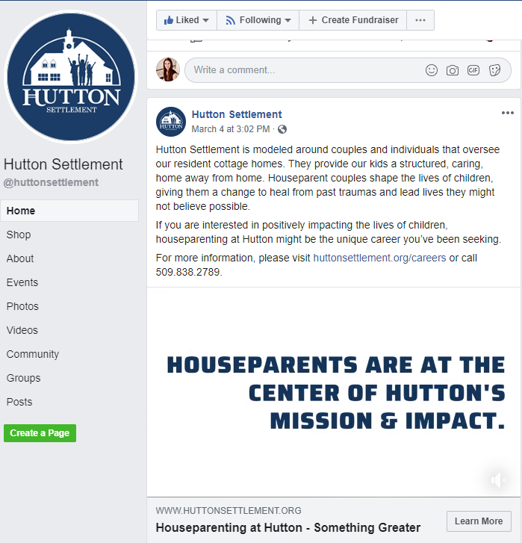
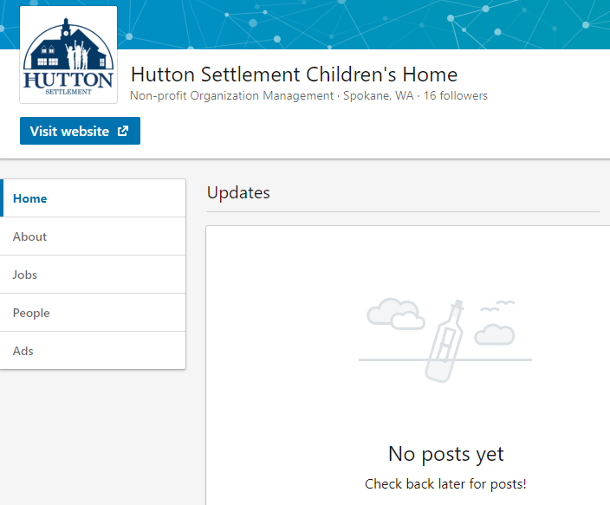
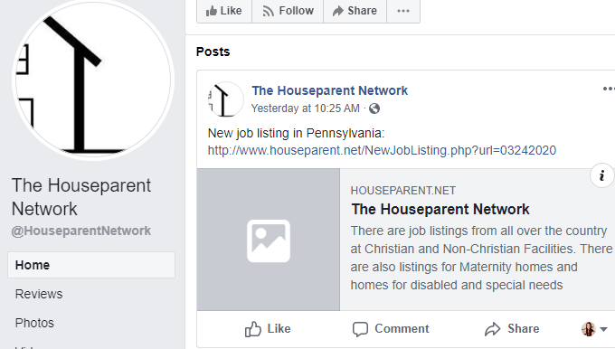
The Power of Social Media
Goal: Expand effective use of social media
Hutton Settlement creates fantastic content on Facebook, including a Houseparent recruitment video
Consider the benefits of joining, or creating, Houseparent Facebook groups for support and job connections.
Use LinkedIn! The current page has no posts. LinkedIn is the primary social media source for job searches.
Use of Social Media Management Software, such as Hootsuite, for ease of posting content on multiple platforms

Slide 17
Effective Use of Job Boards
Goal: Expand use of job boards to reach a larger number of applicants
Research and use job boards specifically for Houseparent positions
Utilize job sites in a wide regional zone to attract candidates wanting to move to Spokane
Job boards specifically for Houseparent positions
https://workingcouples.com/jobs-by-category/house-parent-jobs
http://www.houseparent.net/Direct2.php
https://www.christianjobs.com/jobs/category/house-parent/
Regional job boards
https://jobs.macslist.org/search (Portland) https://afpadvancementnw.org/jobs/ (Seattle)
https://www.worksourcewa.com/ (Washington State)
University job boards
https://gonzaga.joinhandshake.com/
https://ewu.joinhandshake.com/
https://whitworth.joinhandshake.com/

Slide 18
Email Marketing and Community Engagement
Goal: Continuing outreach to Hutton Settlement Alumni as possible Houseparent referrals
Monthly emails and a digital newsletter connect Alumni, the Board of Directors, donors and the Spokane community. From these bulletins could come Houseparent referrals.
Hutton Settlement Alumni could provide Houseparent referrals and spread the word about their success!
Use of email marketing tools, such as Mailchimp, are easy to use and can be managed by a Hutton Settlement intern.

Slide 19
Employee Value Proposition and Hiring Considerations
Goal: Create an Employee Value Proposition that aligns with Hutton Settlement’s values and culture.
An EVP is a statement that defines the value, rewards, and benefits your employees enjoy. Effective EVPs are simple, focused statements that encapsulate why someone would want to work with your organization.* Candidate driven focus: what attracts quality Houseparents? Work environment Compensation model Teamwork Career Training
Consider the interview process. Recommendation for three or less steps with no more than one week between steps if possible.
Align Hutton Settlement values and culture with the hiring process by having a focus on compassion, relationship and respect.

Slide 20
Operational Opportunities
Goal: Turn the Leadership Spokane team’s research* into possible operational changes to improve recruitment and retention
Onboarding
Conduct non-traditional interviews (character-focused)
Require probationary period or relief Houseparent service requirement
Elongate the onboarding and transition period for new Houseparents
Two-day job shadowing as last step of interview process
Benefits
Options for sabbatical or time off
Completely separate living quarters
Technology upgrades onsite
Mindfulness and yoga classes
Costco cards
Performance based reviews and raises

Slide 21
Operational Opportunities (continued)
Other Opportunities
Change in on-campus living options
Additional support staff and bring back onsite therapist
Ongoing, transparent communication about house budgets and upcoming operational changes
Strategic plan for backup during staff changes
Shorter shifts / fewer consecutive days of work
Grandparent volunteers for “babysitting” opportunities
Improve community between houses on campus with weekly dinners, game nights, town hall discussions, etc.
No more than 6 children per family
8 sets of full-time house parents, with 1-2 sets of relief houseparents

Slide 22
Presentation to Hutton Settlement
Members of our team Zoomed with Hutton Settlement on May 26, 2020 to discuss our recommendations.

Slide 26
Large image
Photo of us giving solution document to Hutton?

