Slide 1
Leadership Spokane Community Service Project –
Allie Hyams, Ryan Whitaker, Joshua Zartman, Justin Hanson, Amanda Kenerson, Dolly Ramminger, Zach Gallaher, Fernando Jauretche, Jake Patterson, Heather Brooks

Slide 2
Outline
About Wishing Star Foundation
Timeline
Wishes & Wine 2023 Recap
Current Wishes
Testimonial from Wishing Star Foundation
Summary

Slide 3
About Wishing Star Foundation
Mission
Provide wish kids with hope
Provide lasting support and memories for wish families
Treat families and associates with dignity and protect their privacy
Inspire greater community participation
Founded in 1983 by Karen and Ed Kurowski
Different from other wish programs by offering “Beyond the Wish” program
1,250 families have been served.
Approaching 30th anniversary with former wish kids taking the lead in granting the next generation of wishes.

Slide 4
Timeline
Team randomly selected for first pick during day of class. Wishing Star Foundation identified as our top choice
Teams formed at Leadership Spokane retreat
Roles and responsibilities assigned to each person of the team
Registration
Auction
Golden Ticket
Dessert Dash
Table Decorating
September 2022
October 2022
Nov. 2022
December 2022
First meeting between Leadership Spokane team and Wishing Star to learn about project needs
Team holds first meeting to select our top three community service projects

Slide 5
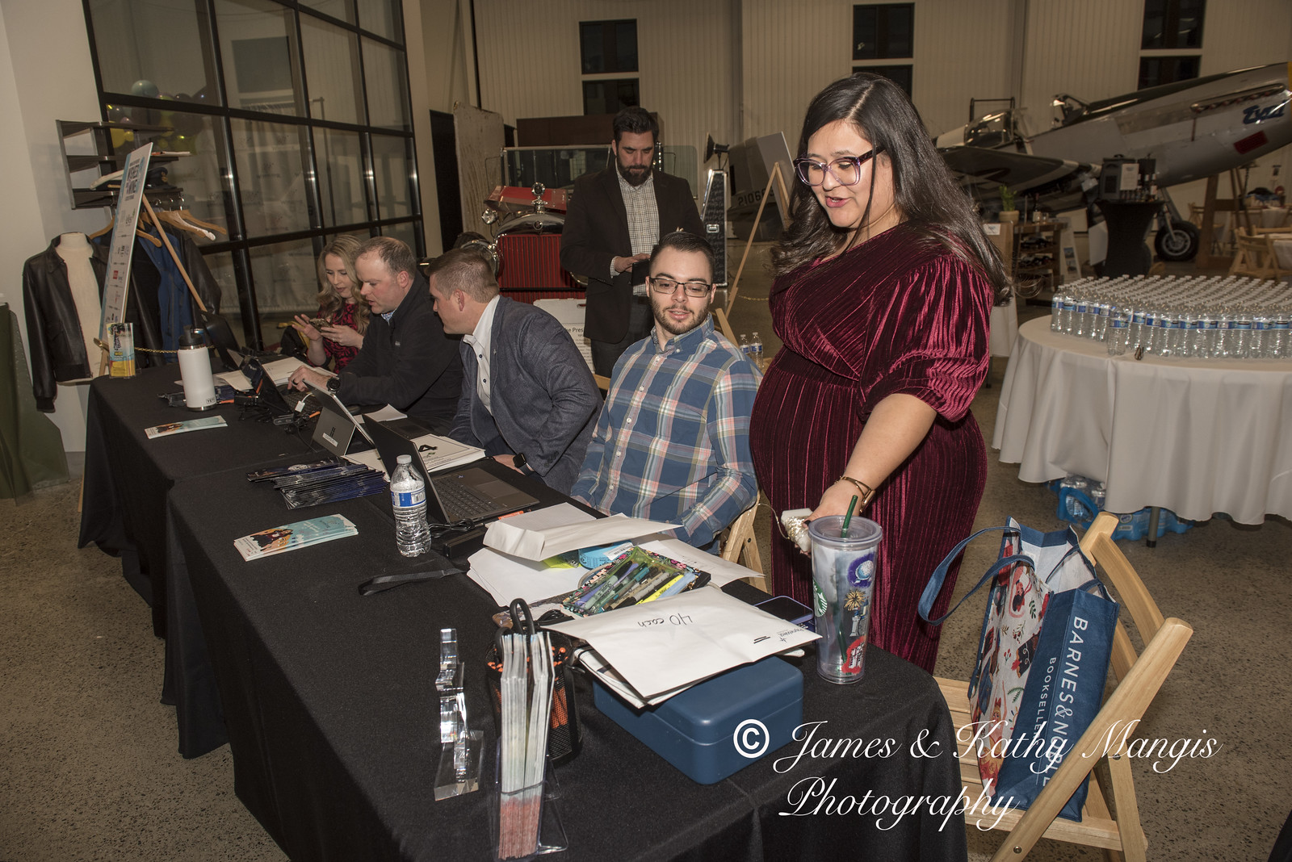
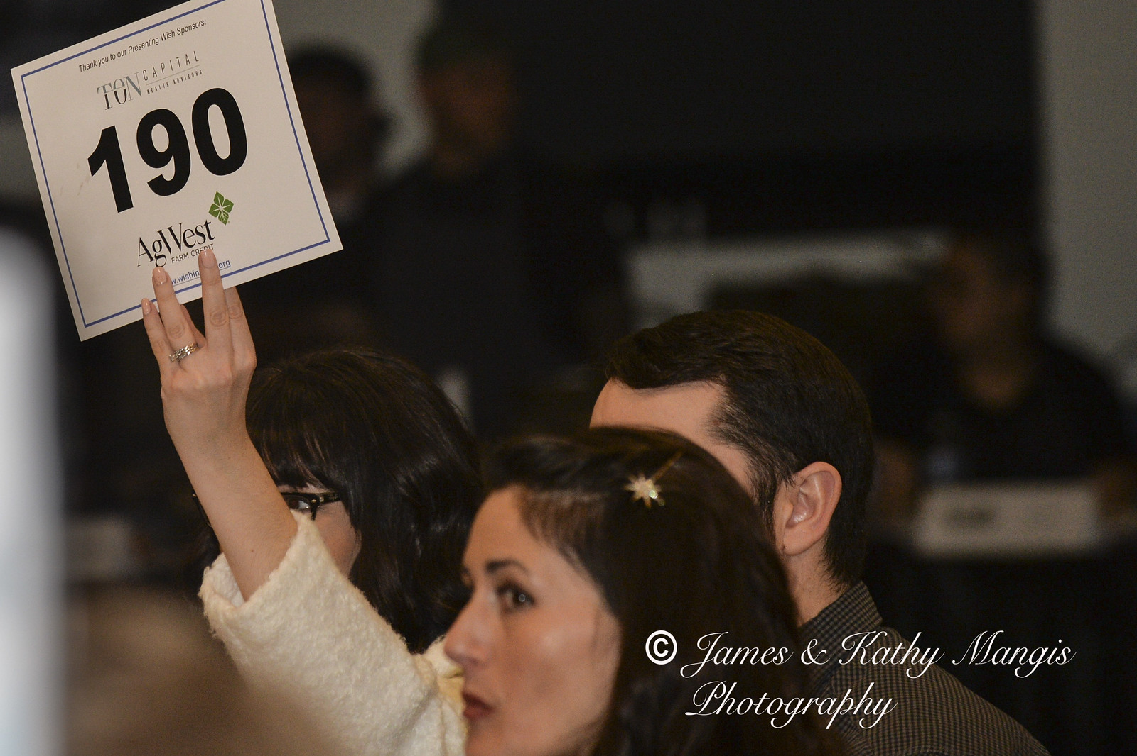
Timeline
Volunteer training on registration software
January 13, 2023
January 20, 2023
January 28, 2023
Dessert Dash items assigned to volunteers for pickup for day of event
Wishes & Wine
A TASTE of Spokane

Slide 7
Current Wishes
Matthew and Shane, twin brothers who have Tourette’s want to go to Disneyland!
Chloe, neuromuscular disease, wants a gaming themed bedroom!
Colton, Cerebral Palsy and epilepsy, wish to be determined
Jaxson, lissencephaly, wants a hot tub for the family
LaMarquise, life threatening genetic disorder, wants to go to Disneyworld!
Kaylee, type 1 Diabetes, wants to go on a road trip with her family
Madelyn, spastic quadriplegia, wants to see Dear Evan Hanson on Broadway

Slide 8
Cindy Guthrie-Tripp
Director of Community Partners & Development
Wishing Star Foundation

Slide 9
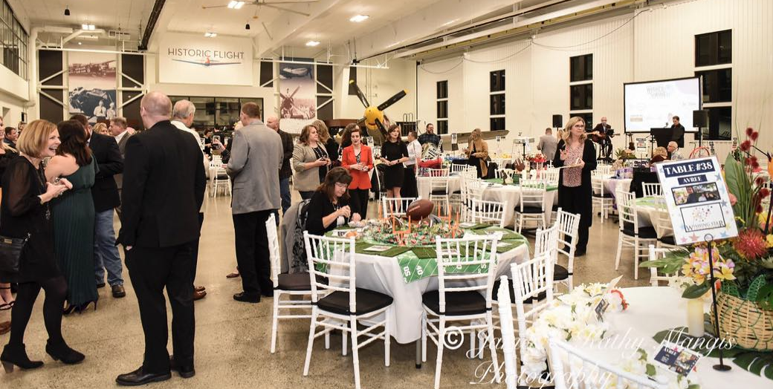
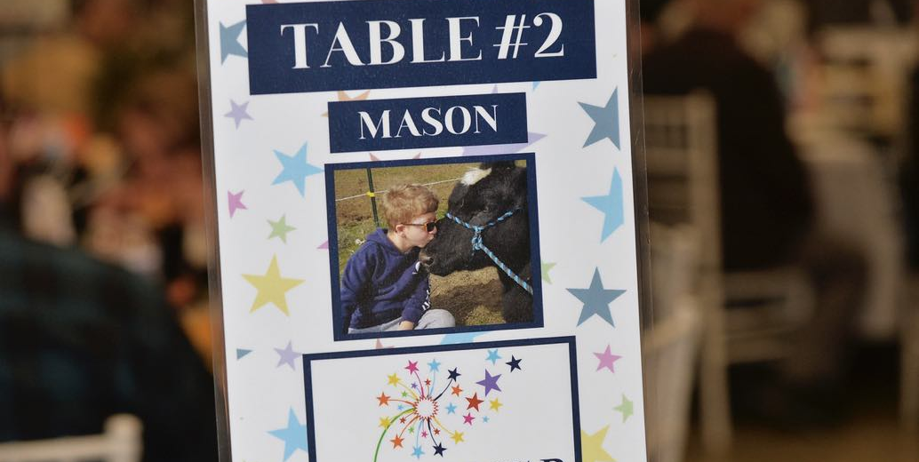
Summary
This Leadership Spokane Community Service team helped The Wishing Star Foundation raise $133,000 at the Wishes & Wine – A TASTE of Spokane 2023 event.

Slide 10
Thank you
Leadership Spokane Community Service Team – Wishing Star Foundation

