Slide 1

Leadership Spokane: A History of Community Leadership

Slide 2
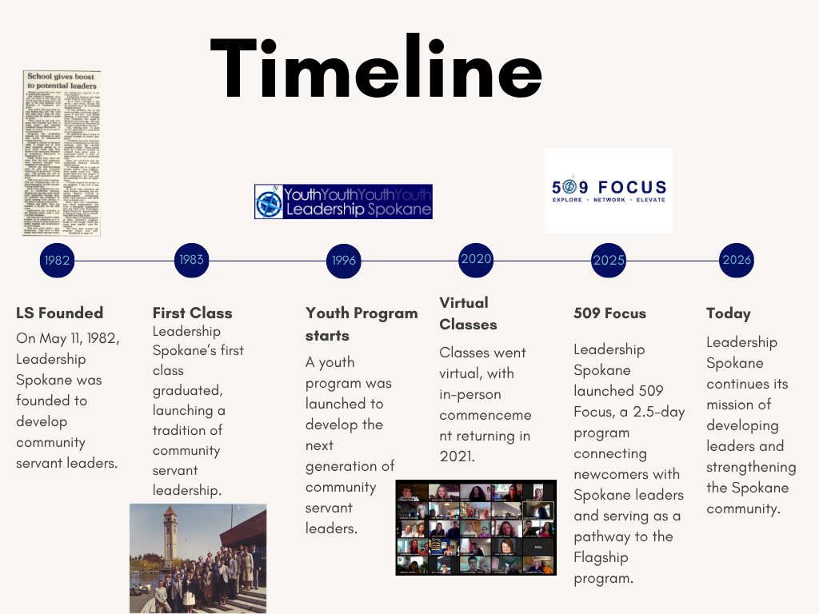

Slide 3
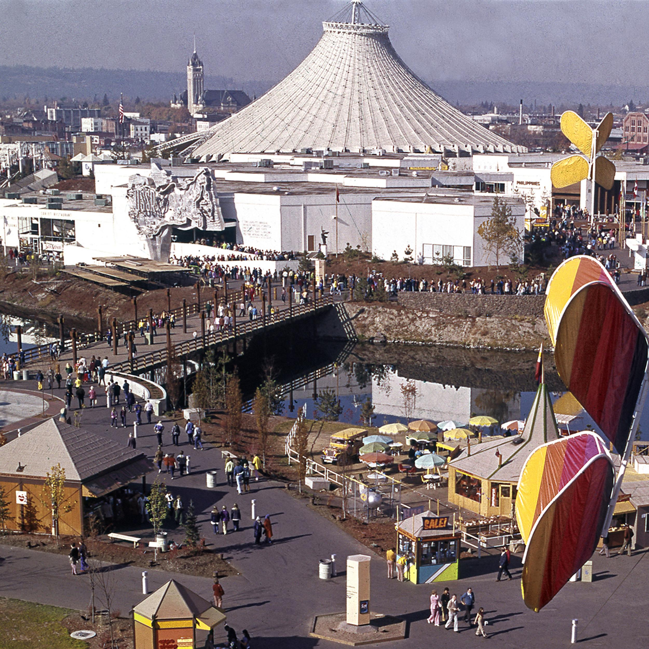

The Beginning: Spokane After Expo ’74
Expo ’74 transformed Spokane & demonstrated the community’s ability to tackle major projects.
Community, business leaders wanted to build on that momentum.
They began exploring ways to develop the next generation of Spokane leaders.
Leadership programs were gaining momentum across the country.

Slide 4

New civic leadership program is established
Leadership Spokane was founded in 1982 by the Spokane Area Chamber of Commerce and local leaders.
Its goal was to strengthen civic leadership and community engagement.
The program brought together leaders from diverse industries and sectors.
The vision: Spokane’s future depends on informed, engaged leaders.

Slide 5
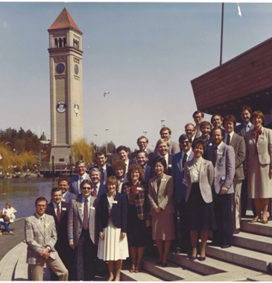
1983: The First Class
First Leadership Spokane class graduated in 1983.
27 participants made up the inaugural class.
This class established the tradition that continues today.
Alumni from the first class became part of the organization’s long-term leadership network.
The inaugural class is now commemorated through the 1983 Society/ Alumni organization.

Slide 6
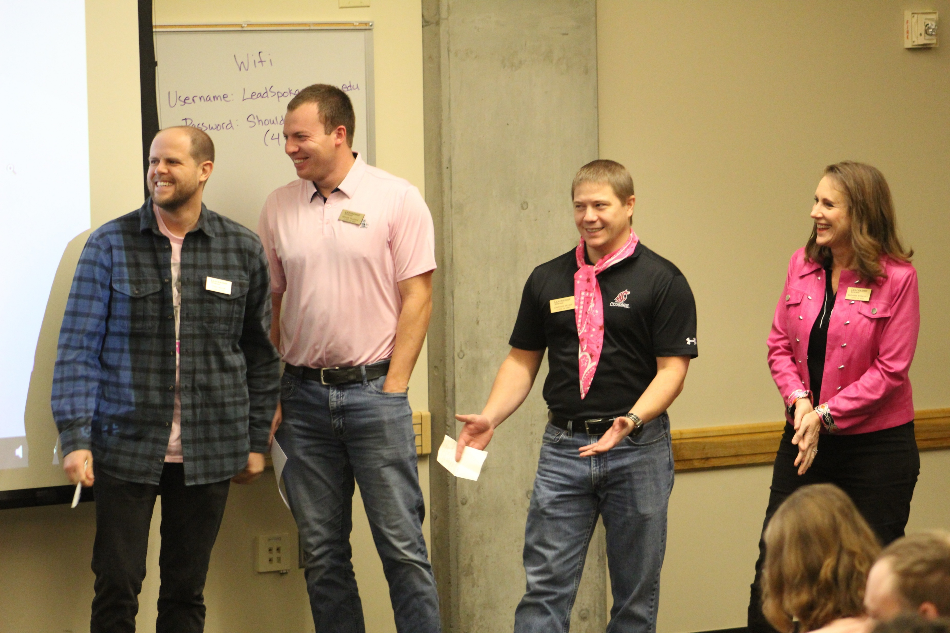
Learning Spokane to Lead Spokane
The program wasn’t simply about leadership skills.
Participants were encouraged to understand:
Spokane’s history
Regional economy
Government and governance
Education
Health and human services
Arts and culture
Community issues
Media and communications

Slide 7
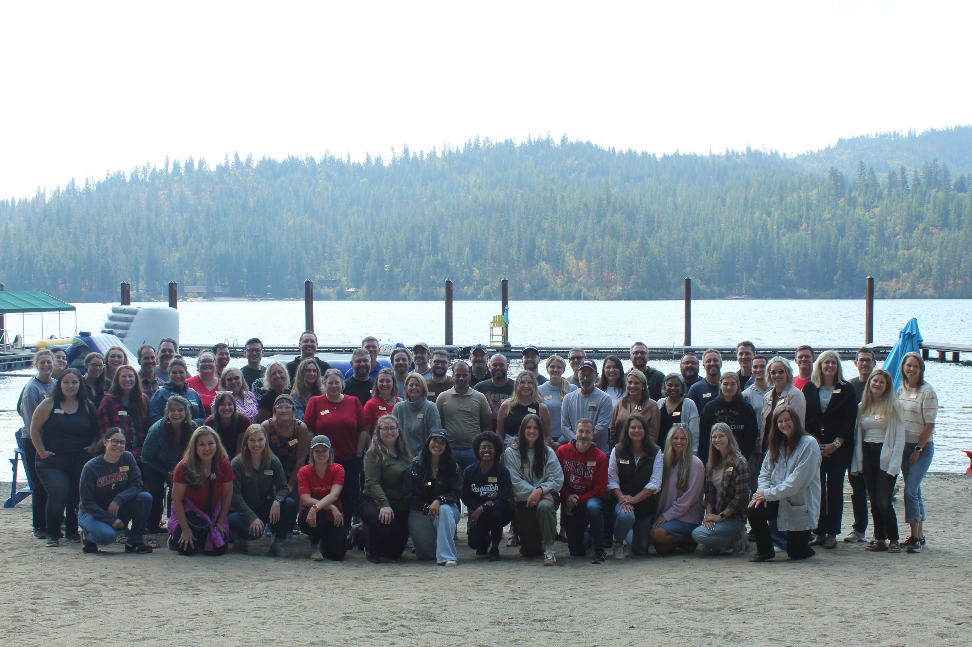
Different Industries. One Community.
Leadership Spokane brings together people from diverse sectors and industries.
Participants have represented business, government, nonprofits, education, health care, law, media, arts and community organizations.
The program emphasizes learning from one another and building connections across sectors.

Slide 8
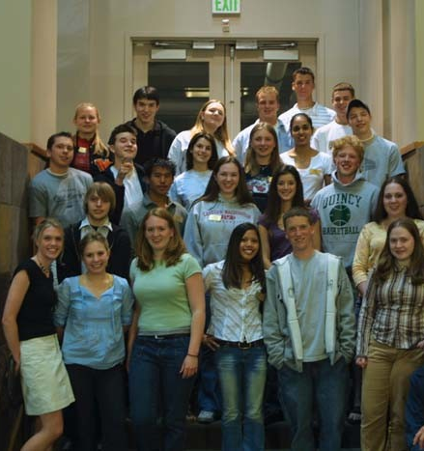
YLS: Investing in the Next Generation
1996: Youth Leadership Spokane was established for high school students.
The first class had 30 students focused on civic leadership and community issues.
Today: The program has produced 866 graduates and remains a key Leadership Spokane program.
Notes:
Photo of our 2003 class, couldn’t find class of 1996 photo in Dropbox

Slide 9
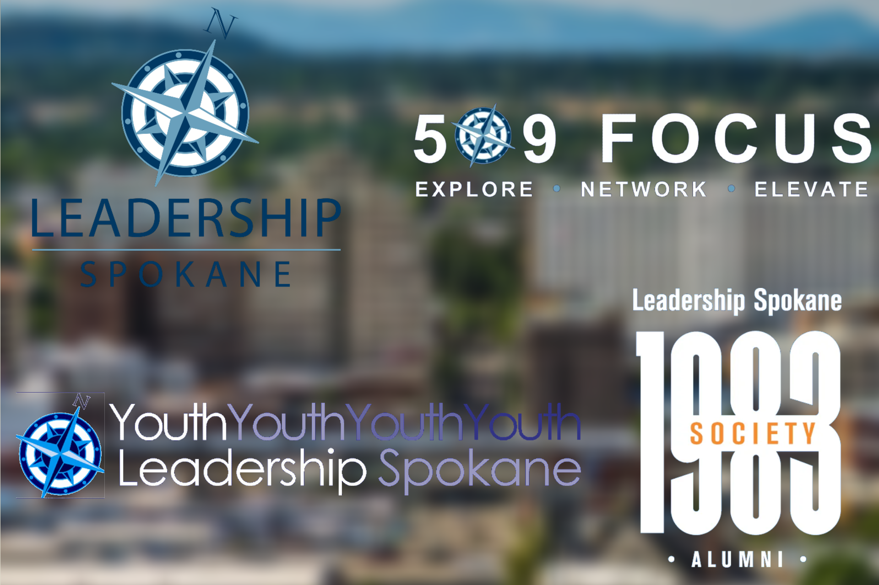
What Leadership Spokane Looks Like Today
Flagship Leadership Program: Civic and servant leadership, Spokane 101, regional economy, government, education, human needs and arts and culture.
Youth Leadership Spokane: Developing high school leaders through civic engagement and service.
509 Focus: Leadership Spokane launched 509 Focus, a 2.5-day program connecting newcomers with Spokane leaders and serving as a pathway to the Flagship program.
Alumni / 1983 Society: Connecting graduates and continuing leadership development.

Slide 10

What Has Stayed the Same?
Despite changes over four decades, several things remain consistent:
Community first
Servant leadership
Cross-sector collaboration
Understanding Spokane
Building relationships
Preparing the next generation
Giving back

Slide 11
Conclusion
“We are a catalyst — educating and uniting diverse, collaborative leaders to ensure a vibrant Spokane.”

Slide 12

Q & A
Use this portion of your presentation to answer audience questions.

