Slide 1

Embrace Washington
SANTA BREAKFAST

Slide 2

Embrace Washington has been enriching the lives of children living in foster care throughout 13 counties in eastern Washington since 2014.
The nonprofit fulfills the unique needs of children experiencing foster care to build foundations for a brighter future and has uplifted over 14,000 children so far.

Slide 3
Embrace WA programs
Sleep Safe
Provides a bed and bedding tailored to the needs/interests of the child and keeps siblings together
Duffels for Darlings
Provides duffel bags so foster kids don’t have to put their belongings into a trash bag
Welcome Boxes
Provides children a box filled with a book, a toy, and other items at their social worker’s office
YMCA Scholarships
Provides YMCA Family Memberships to help foster families connect through activity and play
Education
Connects families with tutors, as emotional trauma and frequent moves challenge learning
Healthcare Assistance for Little Ones
HALO provides access to receive diverse and comprehensive medical assistance
Santa Breakfast
Creates Christmas magic for foster kids and their families

Slide 4
Santa Breakfast
ONE OF THE MOST MAGICAL WAYS EMBRACE WA BRINGS ITS MISSION TO LIFE IS THROUGH SANTA BREAKFAST, A JOYFUL MORNING WHERE FOSTER FAMILIES COME TOGETHER FOR A WARM MEAL, HOLIDAY CHEER, AND A CHANCE TO SIMPLY BE KIDS—ALL WHILE TAKING THE FINANCIAL BURDEN OFF FAMILIES FOR SANTA PHOTOS, BOOKS, GIFTS FOR PARENTS, AND SO MUCH MORE.

Slide 5
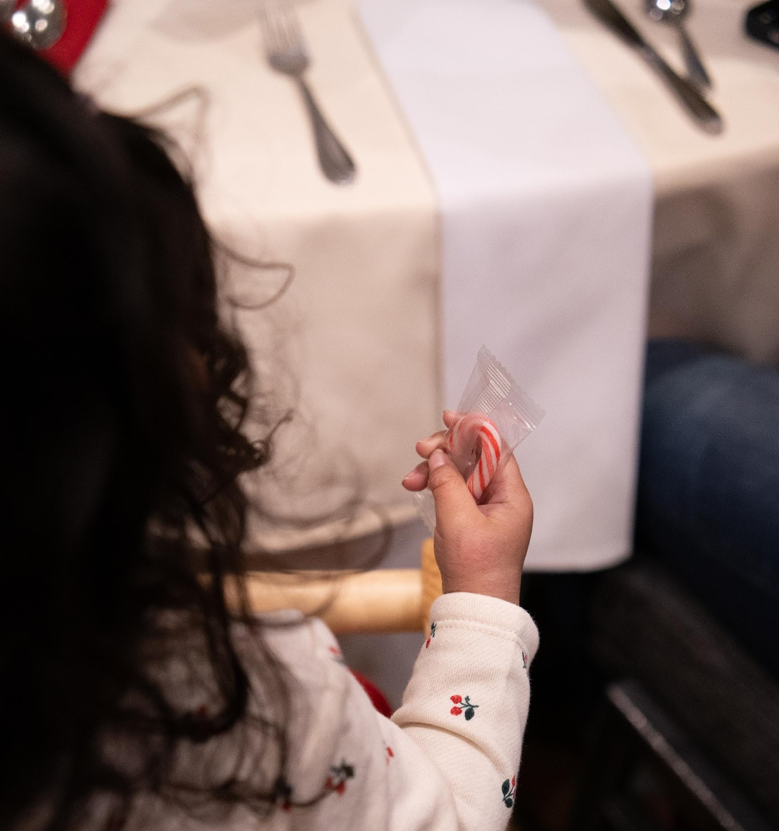
Project overview
Our volunteer team served as table hosts at Embrace Washington’s Santa breakfast, supporting foster families and creating a joyful holiday experience.

Slide 6
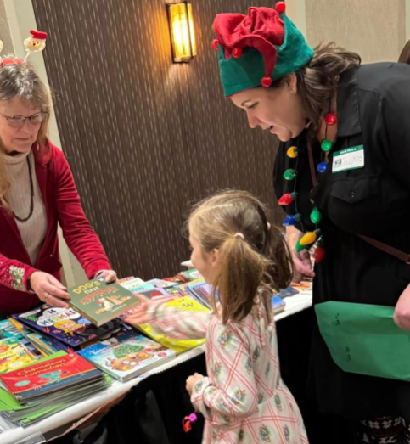
Table host role
Assist 1-2 families each with tasks including:
Snapping Santa photos
Helping kids pick out gifts for trusted adults
Picking out books and stuffed animals with kids
Assisting with raffle basket entries for local experiences
Helping with table clean-up
Taking presents to vehicles
Snuggling babies!

Slide 7
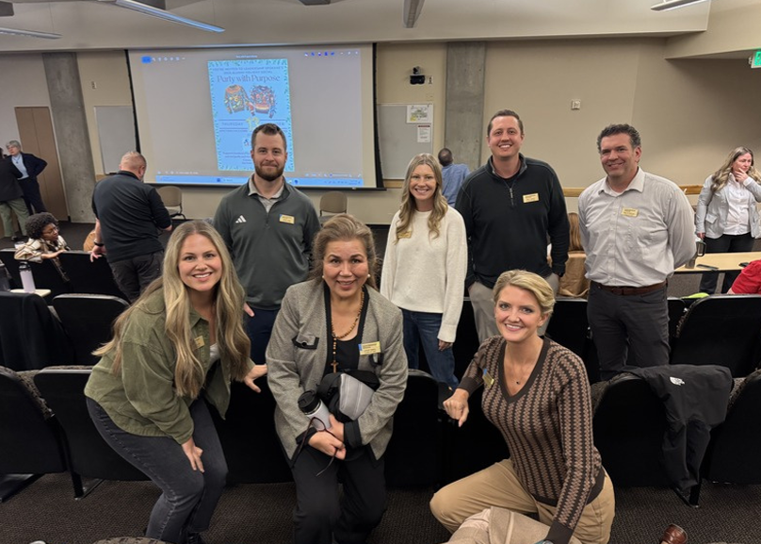
Project planning and teamwork
Prep meetings | 19.5 hours
Santa Breakfast | 66 hours
Post meetings | 23 hours
Total volunteer hours | 108.5 hours
Leveraged each others strengths and time restrictions
Team members volunteered outside of the event:
  Spent time preparing for our roles
  Engaged companies in donating gift baskets for the family drawing
  Helped clean up after the event

Slide 8


Slide 9
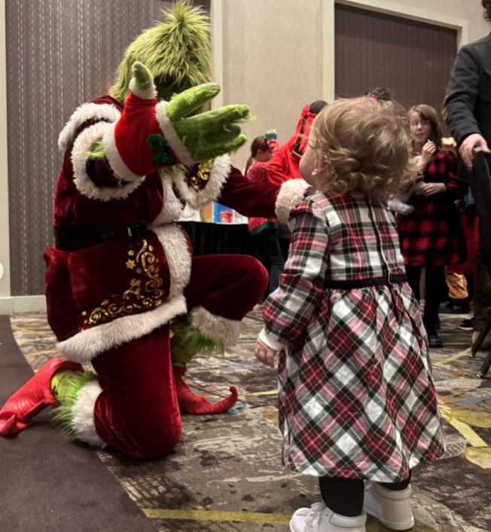
Our impact
Supported foster families in our community
  192 adults
  370 children
Helped create a memorable holiday experience
Learned more about Embrace Washington and the families they serve and are now able to spread this knowledge within our own communities

Slide 10
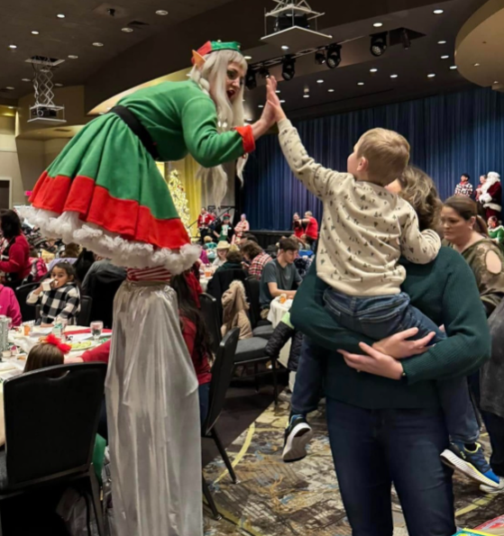
Team reflections
“It was invigorating to be in a room with so many happy, smiling people.” - Mike
“This event brought genuine joy to families while forming deeper connections among everyone involved.” - Brett
“We saw a glimpse of a community that really steps up to support each other, despite the challenging mission.” - Brian
“Seeing the community rally was truly special—bringing joy, connection, and a sense of belonging to foster families.” - Jolene
“This event brought together families from diverse backgrounds to celebrate together, fostering inclusion, connection, and a sense of belonging.” - Jackie
“The number of lives touched hit me hard, it was indescribable.” - Kevin

Slide 11
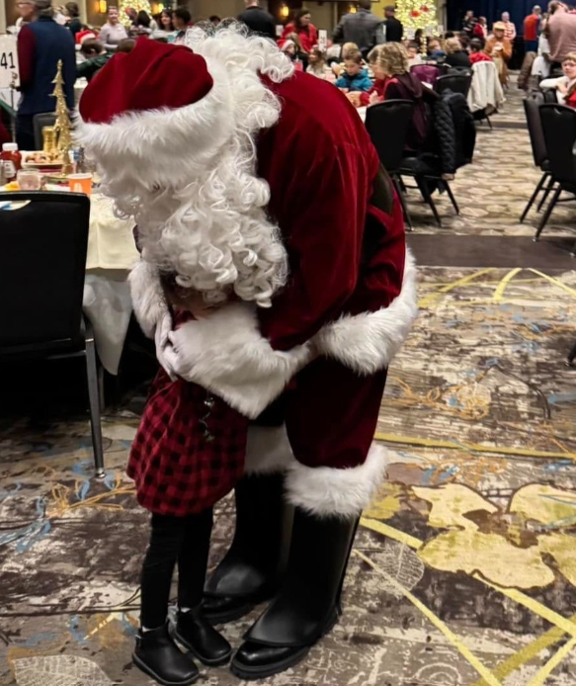
Team reflections
“Being part of this event was both humbling and inspiring. Hundreds of volunteers came together to create a meaningful experience for foster families, showing how much good can happen when people choose to serve others together.” - Austin
“This was super fun. There is nothing better than watching kids experience the magic of Christmas!” - Rachael
“The family I sat with said this is the event that makes them feel the most seen as foster parents.” -Paige
“This event was a powerful reminder that small moments of care and connection can mean everything.” - Scott
“This event ran like a well-oiled machine, with smiling faces on both young and old!”- Travis

Slide 12
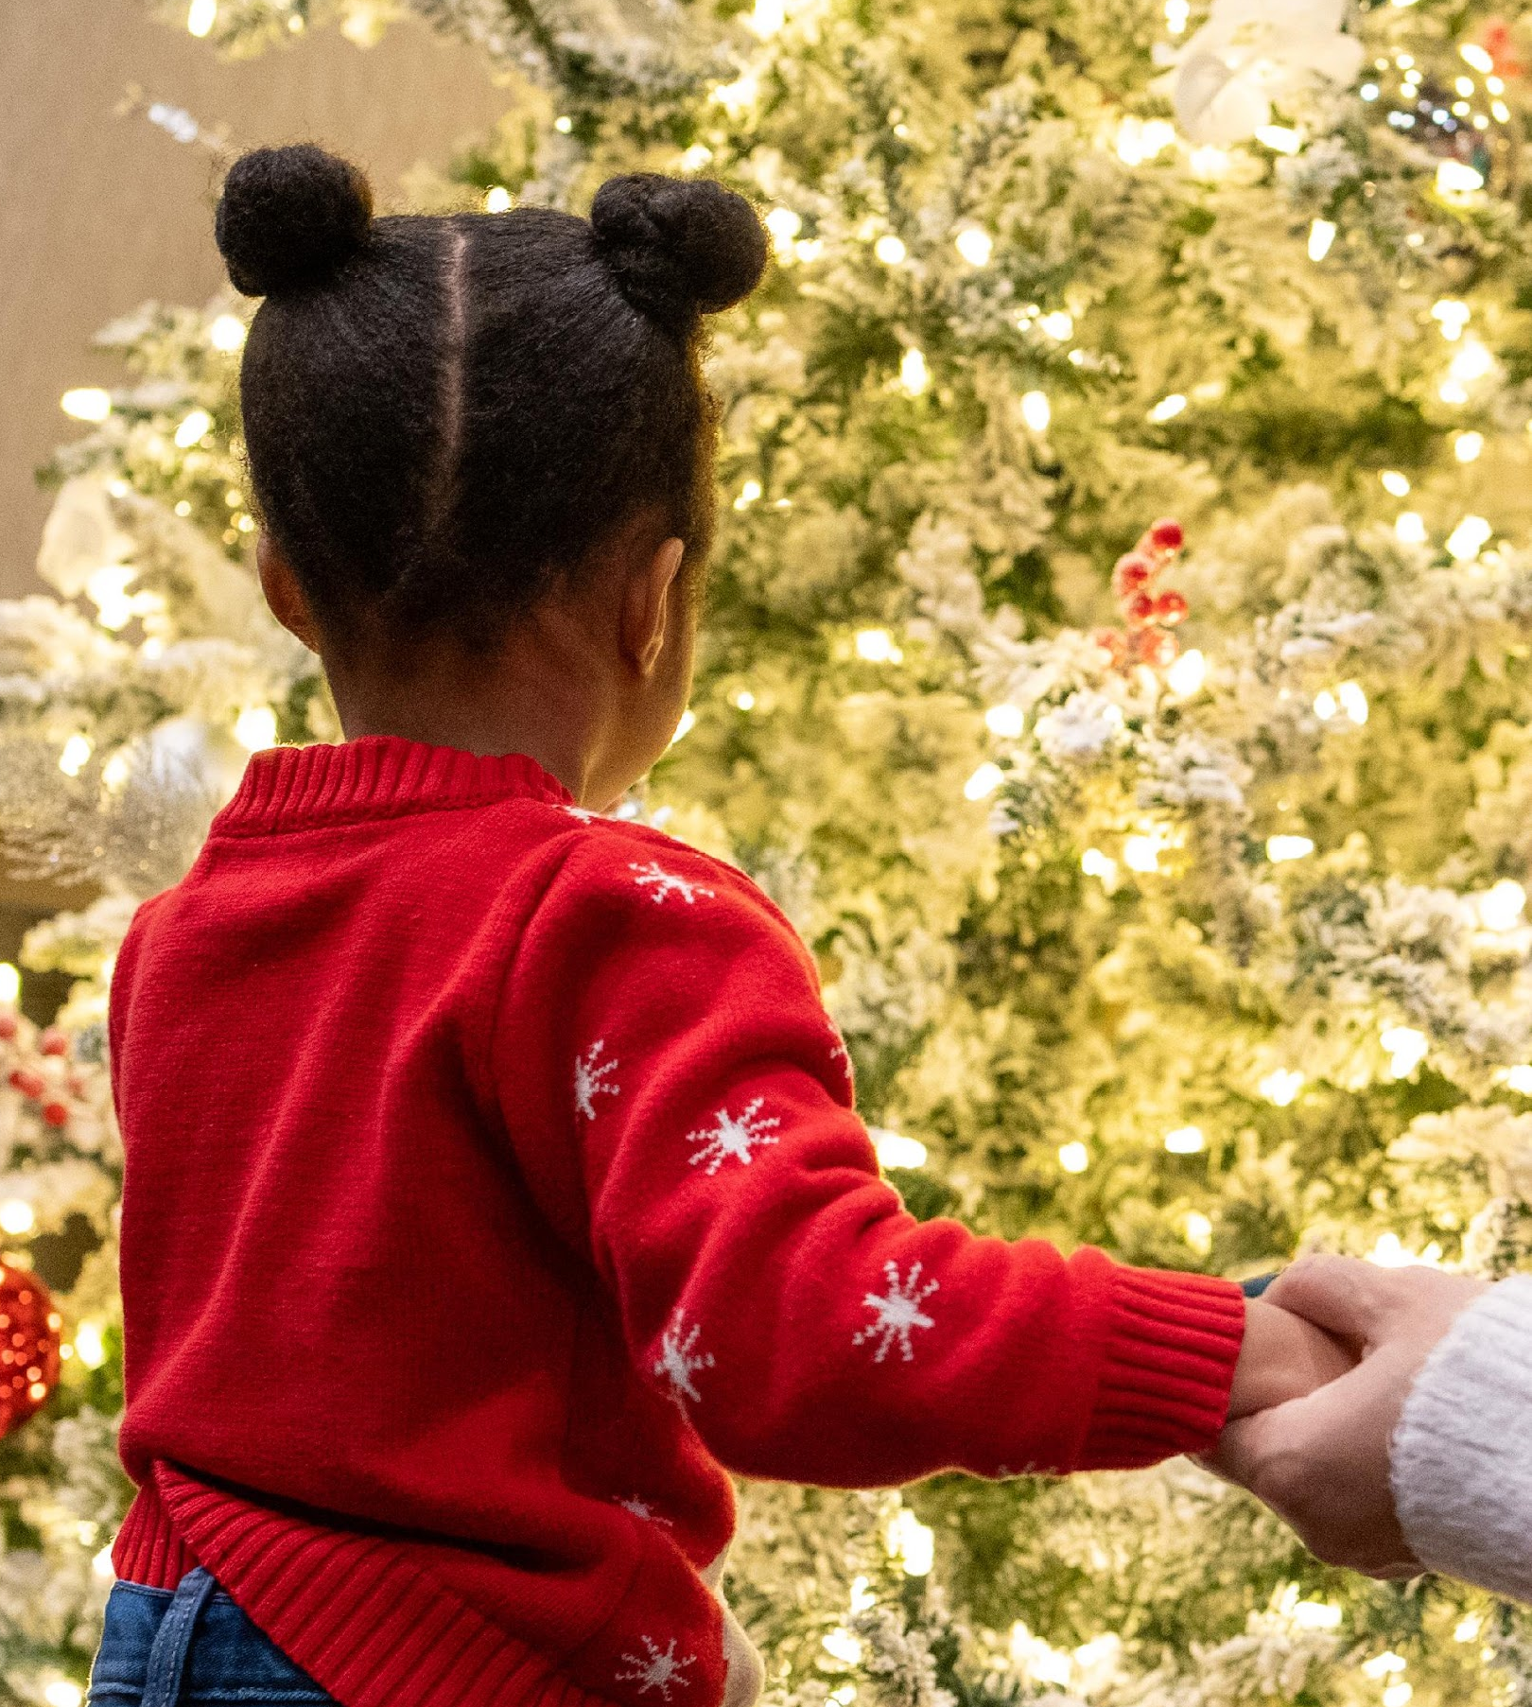
Conclusion
Embrace Washington’s Santa Breakfast is more than a holiday event, it’s a meaningful reminder of what community can do when it comes together with intention and care.
Through simple acts such as sharing a meal, helping a child pick out a gift, creating space for joy, we helped foster families feel seen, supported, and celebrated.
This experience deepened our understanding of the challenges foster families face and strengthened our commitment to showing up for our community in ways that truly matter.
As we move forward, we carry these moments with us, continuing to build connections, uplift families, and support organizations like Embrace Washington that are changing lives every day.

Slide 13
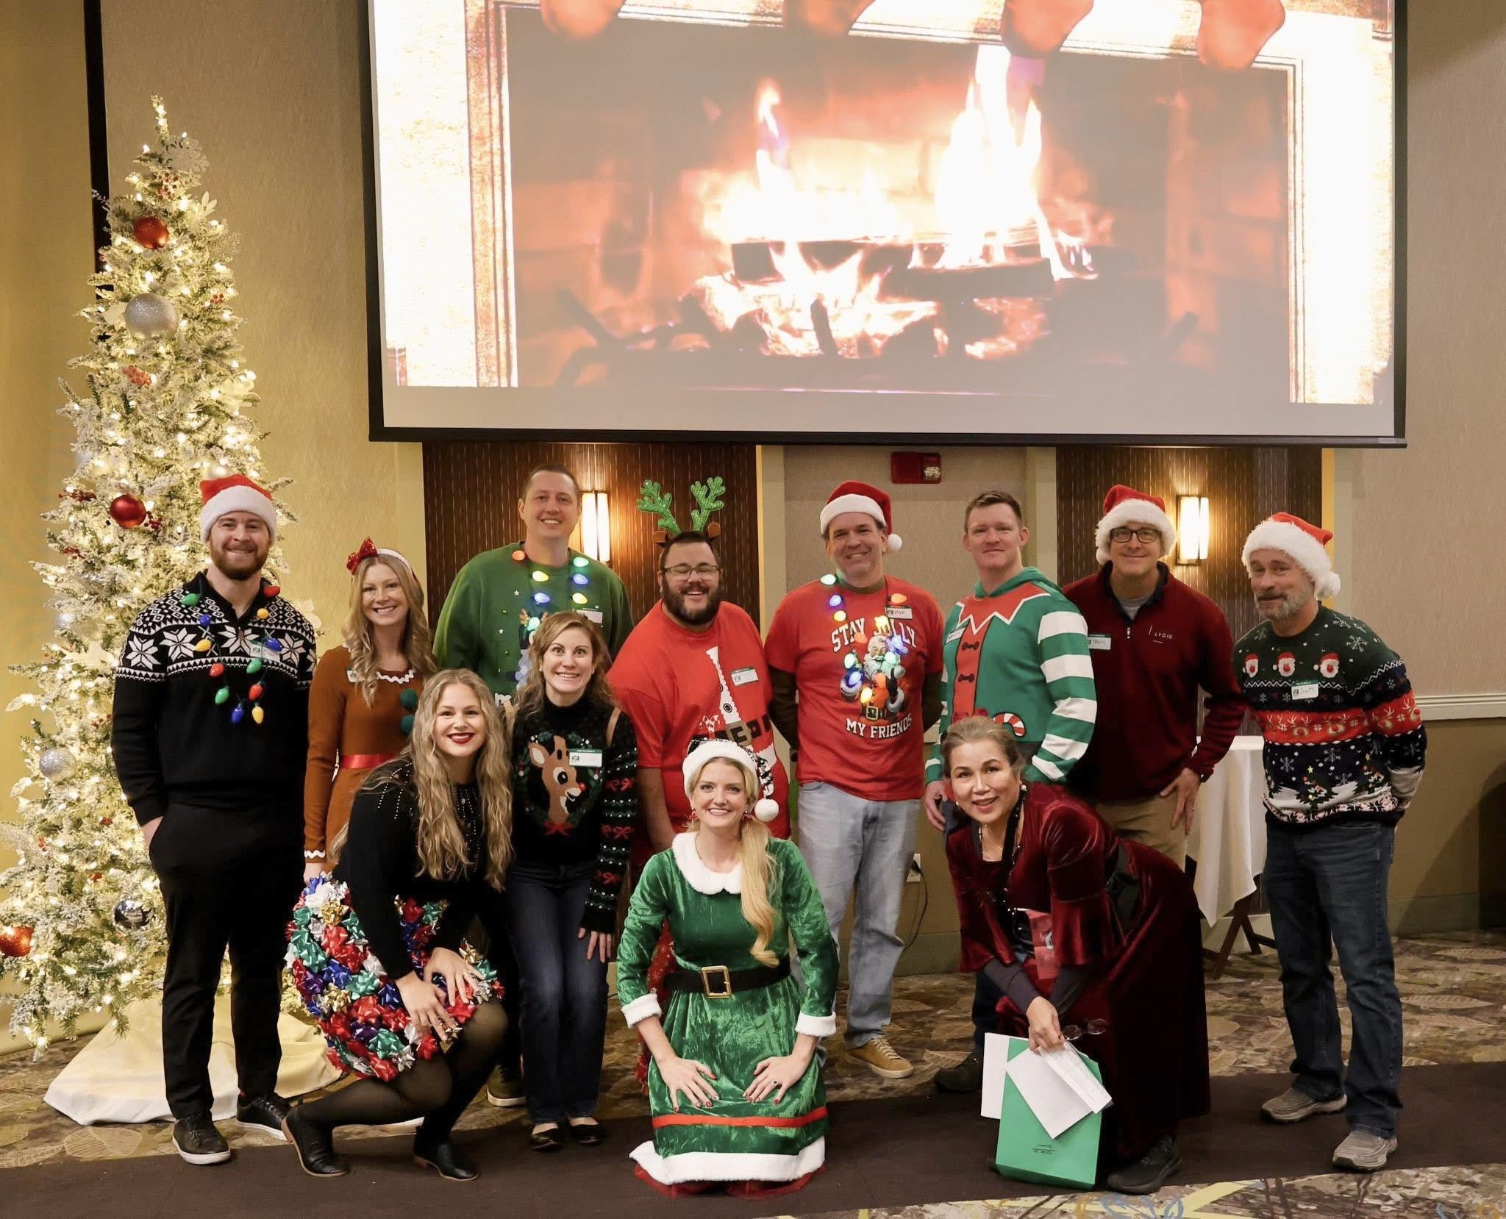
Thank you!
Austin Schmidt
Brett Bailey
Brian Cobb
Jackie Babol
Jolene Severs
Kevin Shilley
Mike Thompson
Paige Lawson
Rachael Curtis
Scott Buck
Travis Semler

